Slide 1
Social Determinants of Health (SDOH) Integration

Slide 2
Introduction
Healthcare Outcomes = Medical + Non-Medical Factors
Social, economic, and environmental determinants (SDOH) influence nearly 80% of overall health outcomes.
Current Challenge
Traditional payer/provider analytics focus mainly on clinical data.
Lack of SDOH integration creates blind spots in equity, care delivery, and health outcome predictions.
Impact on U.S. Healthcare
Health inequities and avoidable utilization cost the system over $320 billion annually.
Vulnerable populations face higher risks due to poverty, housing insecurity, food deserts, and environmental exposures.
Need for Action
A comprehensive integration platform is essential to bring together clinical + community-level SDOH data.

Slide 3
Understanding of the usecase/requirement
Use Case 9: Social Determinants of Health (SDOH) Integration
Aim: Integrate SDOH data with healthcare analytics to reduce disparities and improve outcomes.
Domain Challenge
SDOH account for 80% of health outcomes, yet are rarely included in payer analytics.
Health equity gaps cost the U.S. healthcare system $320 billion annually due to avoidable utilization and poor outcomes.
Problem Statement
Develop a platform that integrates member health data + community-level SDOH.
Identify at-risk populations, predict outcomes, and recommend targeted interventions to close equity gaps.

Slide 4
Datasets
Primary: CDC Social Vulnerability Index (SVI)
Secondary: Census American Community Survey (ACS)
Tertiary: USDA Food Access Research Atlas
Supporting: EPA Environmental Justice Data
Technical Requirements
Geocoding & spatial analysis
Multi-source data integration (health + social + environmental)
Health equity measurement frameworks
Predictive modeling for SDOH impact
Community resource mapping & intervention targeting

Slide 5
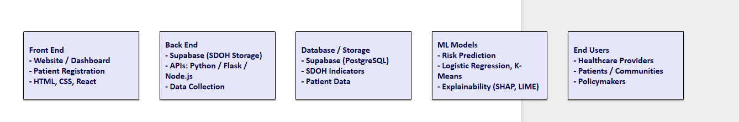
Technology Stack (SDOH Integration)

Slide 6
Solution
Dependencies on External Systems
Relies on multi-source SDOH datasets (CDC SVI, Census ACS, USDA, EPA) combined with patient health records.
Requires geocoding & spatial analysis to connect community-level indicators with individual-level health data.
Needs secure cloud-based storage & processing (Supabase, PostgreSQL, AWS/Azure/GCP) to handle sensitive health + social data.
Predictive analytics powered by machine learning frameworks (TensorFlow, PyTorch, Scikit-learn).
Dashboards & visualizations built using BI and analytics tools (Tableau, Power BI, Plotly).

Slide 7
Proposed Approach
Data Ingestion Pipelines → Automate integration of health, social, and environmental datasets.
Risk Prediction Engine → Identify vulnerable populations using ML models (Logistic Regression, K-Means, Clustering).
Health Equity Measurement → Track disparities and equity indicators with explainability tools (SHAP, LIME).
Community Resource Mapping → Provide targeted interventions (food security, housing, environmental improvements).
Stakeholder Dashboards → Actionable insights for providers, payers, and policymakers to reduce disparities and costs.

Slide 8
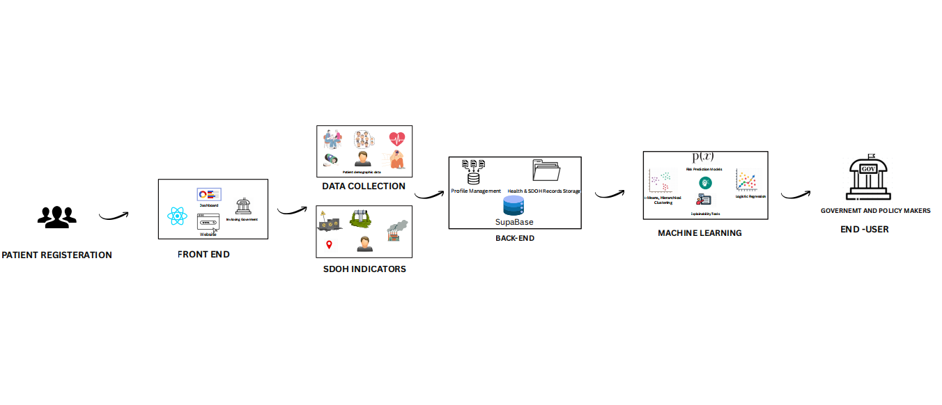
Architecture diagram

Slide 9
Code sample
// Dashboard.jsx
import { useEffect, useState } from "react";
import api from "../api";
import {
BarChart, Bar,XAxis,YAxis,Tooltip,ResponsiveContainer,
Legend,ScatterChart, Scatter,ZAxis,RadarChart,PolarGrid,
PolarAngleAxis,PolarRadiusAxis,Radar,CartesianGrid,
Line,ComposedChart, Cell,
LabelList,
} from "recharts";
import ActionCard from "./ActionCard";

Slide 10
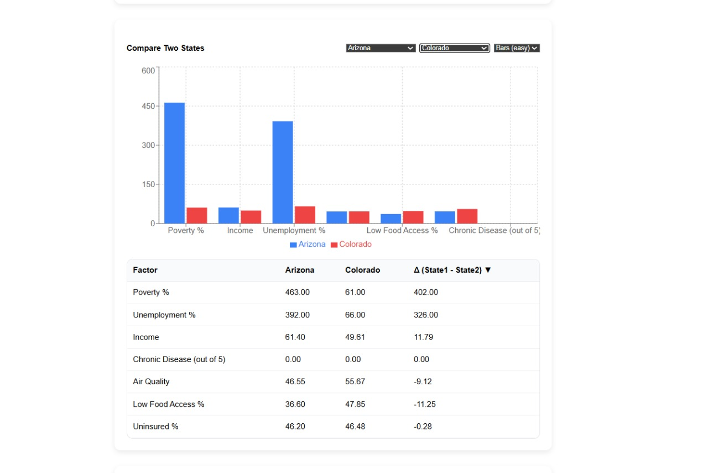
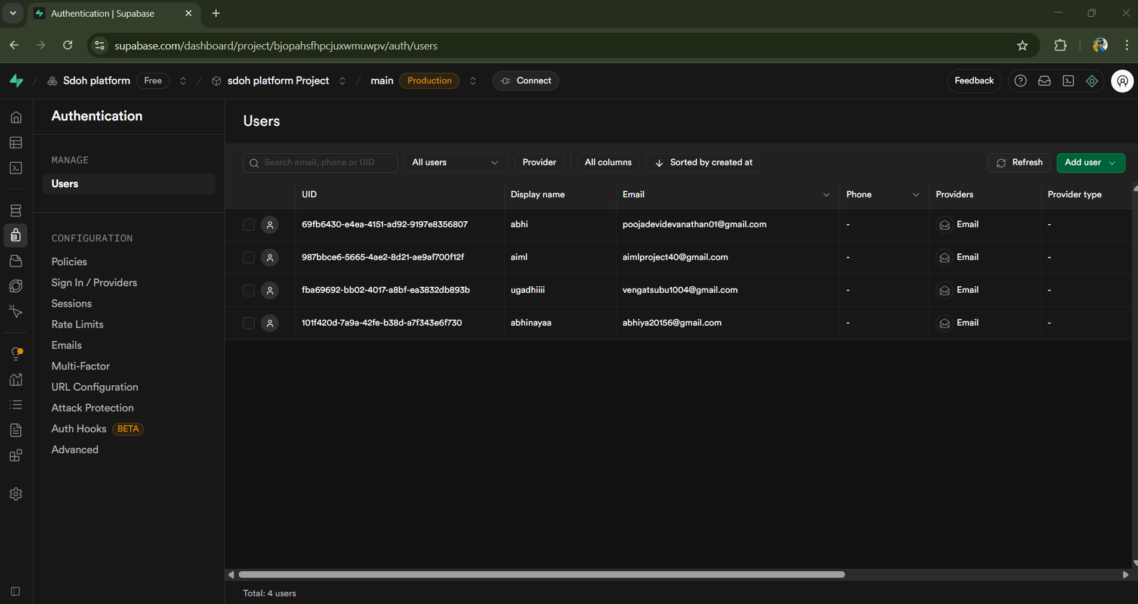
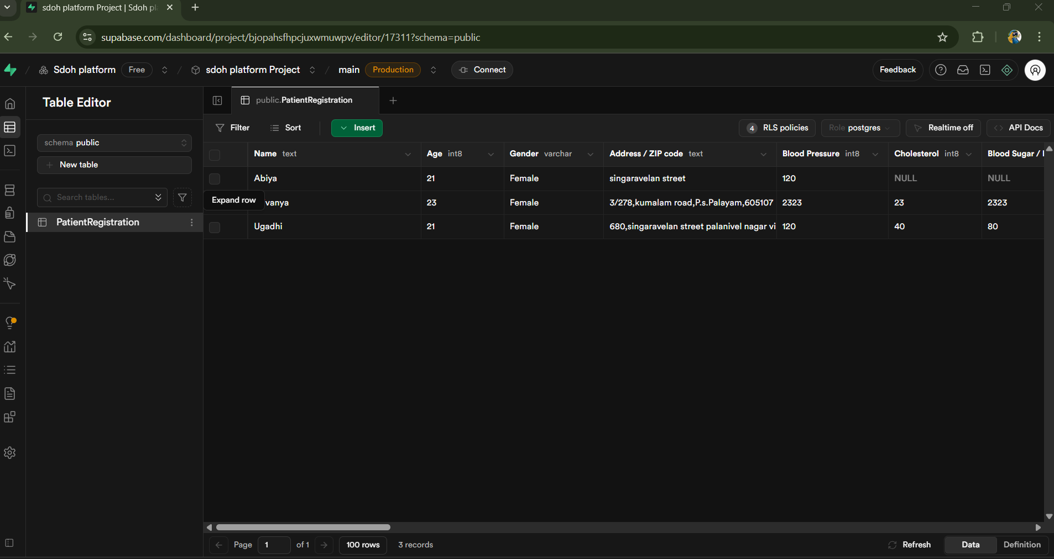
Screenshots from demo

